Slide 1
Substance Use Disorders
Substance use disorder is a condition in which the use of one or more substances leads to clinically significant impairment or distress.
Addiction is characterized by an inability to consistently abstain from substance use causing impairment in daily living.
Without treatment/recovery program addiction typically is progressive and can result in premature death.

Slide 2
About 9% of the population currently use illicit substances.
Marijuana and alcohol are the most commonly used substance.
Most substances of choice directly or indirectly target the reward center of the brain by flooding its circuits with dopamine.
In order for a psychoactive drug to have an effect, it must get to the brain; it must pass through the blood–brain barrier.
Overstimulation of the reward system produces the euphoria that abusers seek and results in continued use of the substance.
Psychoactive drugs: drugs that influence subjective experience and behavior by acting on the nervous system

Slide 3
DSM 5 classifies two major types of substance related disorders
Substance Induced Disorders:
Characterized by abnormal behavior patterns that are directly induced by psychoactive substances.
    Types of Substance Induced Disorders:
        1) Substance Intoxication: being under the influence of a substance; features of intoxication depend on drug used; we see confusion, impaired judgment, impaired motor and spatial skills.
        2) Substance Withdrawal: cluster of symptom emerging when one abruptly stops using a drug; repeated use of a drug alters the body’s physiological reactions; withdrawal sx’s vary with the drug; alcohol withdrawal includes tremors of hand, hallucinations, insomnia, nausea, agitation, anxiety, seizures.
        Chronic heavy users of alcohol can have delirium tremens (DTs) and experience autonomic hyperactivity (sweating and tachycardia) and delirium which is a state of mental confusion including incoherent speech, disorientation, extreme restlessness, hallucinations of creepy animals crawling on their body.
        Caffeine withdrawal may include headache, drowsiness, depressed mood, problems with concentration, flu like symptoms, nausea and muscle stiffness or pain.

Slide 4
DSM V Definition: Substance Use Disorder
Severity: Depends on number of symptoms endorsed
Mild: Presence of 2-3 symptoms
Moderate: Presence of 4-5 symptoms
Severe: Presence of 6 or more symptoms

Slide 5
What is Intoxication?
Behavioral/psychological changes due to effects on CNS developing after ingestion:
Intoxication varies depending on the substance used.
Disturbances of perception, wakefulness, attention, thinking, judgment, psychomotor behavior, hallucinations, paranoia, delusions, euphoria, anxiety, agitation, slowed reaction time, red eyes, dry mouth, increased heart rate
Not due to another medical condition or mental disorder

Slide 6
What is Withdrawal?
Emotional Withdrawal Symptoms:
Anxiety Insomnia Restlessness
Depression Cognitive Impairment
Physical Symptoms:
Headaches Racing Heart
Difficulty Breathing Palpitations
Nausea Vomiting
Muscle Tensions Tremors
Shakes Sweating

Slide 7
Defining the Terms
Abuse- A maladaptive pattern of substance use that impairs ability to function
Dependence- Physiological means your body has changed, relies on the drug.
Psychological dependence means using the drug compulsively to deal with stress or anxiety of the day and their daily responsibilities.
Tolerance- A state which develops after repeated use of the substance and an increased amount is required to produce the same effect
Withdrawal- Signs and symptoms which emerge when a drug is reduced in amount or withdrawn; . Disturbances of perception, wakefulness, attention, thinking, judgment, psychomotor behavior and interpersonal behavior
Not due to another medical condition or mental disorder

Slide 8
Alcohol and Teenagers
Date Rape – one to two-thirds of teen sexual assaults involve alcohol
18% of Females/ 39% Males say it is acceptable for a boy to force sex if the girl is intoxicated.
40% of children who start drinking before age 15 will become alcoholics
In television 9 out of 10 drinkers are portrayed as having no effects or only positive outcomes from their alcohol consumption

Slide 9
What Contributes to Development of Substance Use Disorders?
Genes/ genetic variation
About 40-50% of having a substance use problem is genetic.
Males are twice as likely as females to have alcohol or drug addiction
Environment
Family's beliefs and attitudes – Exposure to parental substance use
Peer group that encourages drug use
Adverse Childhood Events
Trauma, mental health, physical health, household dysfunction

Slide 10
Common signs and symptoms of drug abuse
Neglecting responsibilities at school, work, or home (e.g. flunking classes, skipping work, neglecting your children).
Using drugs under dangerous conditions or taking risks while high, such as driving while on drugs, using dirty needles, or having unprotected sex.
Experiencing legal trouble, such as arrests for disorderly conduct, driving under the influence, or stealing to support a drug habit.
Problems in your relationships, such as fights with your partner or family members, an unhappy boss, or the loss of friends.

Slide 11
Risk factors for drug addiction
While anyone can develop problems from using drugs, vulnerability to substance addiction differs from person to person.
While your genes, mental health, family and social environment all play a role, risk factors that increase your vulnerability include:
  Family history of addiction
  Abuse, neglect, or other traumatic experiences.
  Mental disorders such as depression and anxiety
  Early use of drugs
  Method of administration—smoking or injecting a drug may increase its addictive potential

Slide 12
How drug addiction develops
Very few drug abusers or addicts are able to recognize when they’ve crossed that line to addiction.
If the drug fulfills a valuable need:
You may find yourself increasingly relying on it.
You may take illegal drugs to calm or energize yourself or make you more confident.
You may start abusing prescription drugs to relieve pain, cope with panic attacks, or improve concentration at school or work.
To maintain a healthy balance in your life, you need to have positive experiences and feel good about your life without any drug use.
Drug abuse may start as a way to socially connect
People often try drugs for the first time in social situations with friends and acquaintances. A strong desire to fit in to the group can make it feel like doing the drugs with them is the only option.
Problems can sometimes sneak up on you, as your drug use gradually increases over time. Smoking a joint with friends over the weekend, or taking ecstasy at a rave, or painkillers when your back aches, for example, can change from using drugs a couple of days a week to using them every day.
As drug abuse takes hold, you may miss or frequently be late for work or school, your job performance may progressively deteriorate, and you may start to neglect social or family responsibilities.
Your ability to stop using is eventually compromised. What began as a voluntary choice has turned into a physical and psychological need.
Eventually drug abuse can consume your life, stopping social and intellectual development. This only reinforces feelings of isolation.

Slide 13
Drug addiction and the brain
While each drug produces different physical effects, all abused substances share one thing in common: repeated use can alter the way the brain functions.
Taking the drug causes a rush of dopamine in your brain, which triggers feelings of pleasure.
Your brain remembers these feelings and wants them repeated.
When you become addicted, the substance takes on the same significance as other survival behaviors, such as eating and drinking.
Changes in your brain interfere with your ability to think clearly, exercise good judgment, control your behavior, and feel normal without drugs.
The urge to use is so strong that your mind finds many ways to deny or rationalize the addiction.
You may drastically underestimate the quantity of drugs you’re taking, how much it impacts your life, and the level of control you have over your drug use.

Slide 14
Long-term drug exposure impairs brain functioning
Release 2 to 10 times more dopamine than natural rewards (eating, sex and social activities)
Powerful reward strongly motivates people to take drugs again and again.
The brain adjusts - producing less dopamine and reducing the number of receptors that can receive signals
The ability to experience ANY pleasure is reduced.

Slide 15
Why We Turn to Substances?
Because they bring pleasure and euphoria
To avoid unpleasant consequences and the stress of life
It is a learned, maladaptive mechanism to cope with life’s responsibilities
The levels of certain neurotransmitters are altered to produce euphoria and pleasure
Individual living with mental illness use substances to ease their suffering

Slide 16
Acquired Brain Injury
An Acquired Brain Injury (ABI), is defined as an injury to the brain which is not hereditary, congenital, degenerative or induced by birth trauma
It may be mild, moderate or severe
ABI includes many types of traumatic brain injuries caused by:
Stroke: Loss of oxygen to the brain resulting in altered brain function.
Anoxia: lack of oxygen such as from drowning, attempting to hang oneself

Slide 17
Infection: Severe infection of the brain (Encephalitis) or of the membranes (Meningitis) can cause damage to brain cells and their ability to function and impairments may be temporary or permanent.
Tumor: A tumor will act much like a blood clot, as it compresses surrounding tissue causing malfunction.
ABI occurs at the cellular level and is associated with damage to brain tissue.
The extent and effect of brain damage is determined by neuroimaging tests such as an MRI, CT scan and neuropsychological testing.

Slide 18
Causes of ABI:
Aneurysm: a bulging, weak area in the wall of an artery that supplies blood to the brain; aneurysm ruptures, releasing blood into the skull and causing a stroke.
Exposure to toxic substances
Excessive/prolonged use of Illegal substances
Brain cells need oxygen and glucose to survive otherwise they die

Slide 19
Symptoms of Brain Damage:
Cognitive: memory loss, impaired attention, inability to abstract, difficulty processing information, disinhibition, confusion
Behavioral/Emotional: irritability, reduced tolerance for stress, increased aggressiveness, restricted affect, agitation, impatience, depression, anger, anxiety
Perceptual: changes in vision, spatial disorientation, inability to sense time, disorders of smell and taste
Physical: persistent headaches, extreme mental fatigue, paralysis, tremors, slurred speech, seizures

Slide 20

Illicit Substances such as
Amphetamines, Cocaine and Hallucinogens can produce psychosis similar to Sz;
These illicit substances are psychotomimetic
(they mimic psychosis)
Psychotic Disorder
Bipolar Disorder
Depressive Disorder
Anxiety Disorder

Slide 21
Psychotomimetic drugs produce a range of perceptual alterations and distortions.
Sensory inputs are heightened or diminished (colors, sounds, taste and touch become more or less intense)
The individual may have illusions such as distortions in in the perceived nature or meaning of real objects; seeing a grotesque distortion of a familiar face.
The hallucinations produced by psychotomimetic drugs are typically in the visual domain.
Synesthesias may occur where the individual perceives stimuli from one sensory modality in another modality like seeing sounds or hearing colors.
Time perception may be distorted where time slows or moves faster.
Concentration and attention is impaired.
Individuals may feel detached from themselves or the environment (depersonalization)

Slide 22
How do Illicit Drugs Work in the Brain?
Drugs affect the brain by interfering with how neurons send, receive and process information.
Marijuana and heroin activate neurons because their structure mimics a natural transmitter.
This similarity fools the receptors and allows drugs to attach and activate neurons.
These drugs mimic the brain’s own chemicals but they don’t activate neurons like a natural neurotransmitter and they lead to abnormal messages being transmitted.

Slide 23
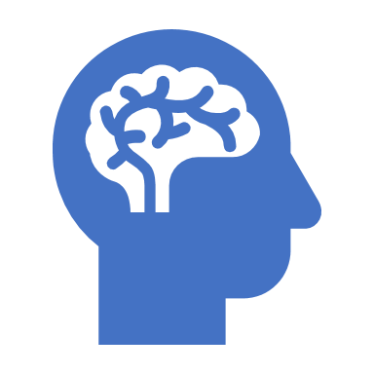
How do Drugs Work in the Brain to Produce Pleasure?
Most illicit drugs target the brain’s reward and pleasure system by flooding the circuit with dopamine.
Dopamine is a neurotransmitter in the brain that regulates movement, emotion, motivation and pleasure.
When activated at normal levels this system rewards our natural behaviors.
Over-stimulating the system with drugs produces euphoria.
Some illicit substances can release up to 10 times the amount of dopamine that natural rewards do.
The effects can last much longer than those produced by natural rewards.

Slide 24
What Happens to Your Brain if You Continue Using Drugs?
Over time, the brain adjusts to the surges of dopamine or other neurotransmitters by producing less dopamine or reducing the number of receptors that can receive signals.
Dopamine’s impact on the reward circuit in the brain of an addict can become abnormally low, and the person’s ability to experience pleasure is reduced and they can develop depression.
The individual then continues to use larger and larger amounts of the drug to produce the familiar dopamine high and we can call this condition tolerance.
The problem is you cannot build a life around continued use of illicit substances.

Slide 25
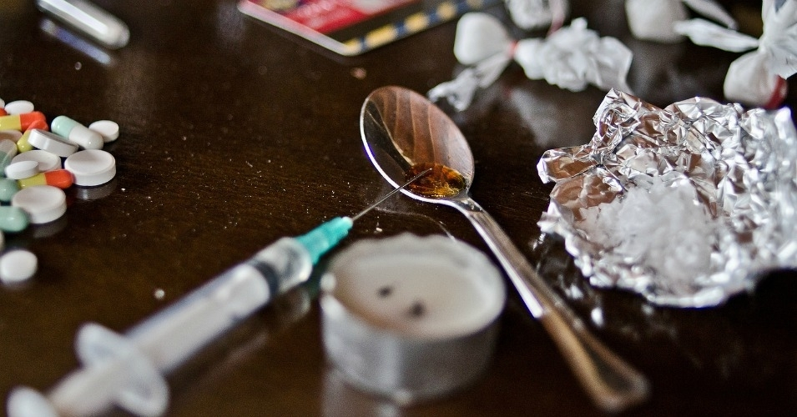
Classes of Substances
Depressants
Hallucinogens
Opioids
Stimulants

Slide 26
Central Nervous System Depressants
A depressant is a substance that slows down the cental nervous system; reduces feelings of tension and anxiety; slows movement and impairs cognitive processes.
In high doses it can arrest vital functions and cause death
Alcohol is a depressant that causes depression of central nervous system activity
Includes alcohol, benzodiazepines, barbiturates, and inhalants
Depressants slow the activity of the central nervous system
Depressants cause the neurons to fire more slowly
In moderate doses, they make people relaxed and somewhat sleepy, reduce concentration, and impair thinking and motor skills.

Slide 27
Central Nervous System Depressants
Benzodiazepines and Barbiturates
Classes include Xanax, Valium, Halcion, and Librium and barbiturates such as Quaaludes. Nembutal, Seconal and Phenobarbital are used for insomnia
Cause decrease in blood pressure, respiratory rate and heart rate.
Can cause respiratory arrest or cardiovascular collapse (overdose)
The Barbiturates are psychologically and physically addictive; they ease anxiety and tension, dull pain, produce euphoria.
High doses produce produce drowsiness, slurred speech, motor impairment, irritability and poor judgment.
Barbiturates combined with Alcohol is very deadly

Slide 28
barbiturates
These include the following and they are sedatives:
  Amobarbital
  Pentobarbital
  Phenobarbital
  Secobarbital
Medical uses are to decrease anxiety and tension, dull pain, treat epilepsy and hypertension.
We form quick psychological and and physiological dependence to these drugs.
The effects of barbiturates last from 3 – 6 hours
Abrupt withdrawal produces:
  Delirium
  Visual, tactile or auditory hallucinations
  Disturbance in thought processes
  Grand Mal seizures and death can occur from abrupt withdrawal.

Slide 29
Central Nervous System Depressants
Alcohol
Intoxication
  BAC .30 -.40- Conscious
  BAC .40-.50- Coma
  BAC .50 or higher-Death

Slide 30
Alcohol Withdrawal
Early
Anxiety, irritability, tremors, insomnia, nausea, tachycardia (increased heart rate) HTN, hyperthermia (elevated body temp), hyperactive reflexes
Seizures
Generally seen 24-48 hours
Most often Grand Mal: Tonic and Clonic
Withdrawal Delirium (DTs)
Generally between 48-72 hours
Altered mental status, hallucinations, marked autonomic instability (dizziness, fainting)
Can be life-threatening

Slide 31
Effects of Alcohol
Long-term effects
  Permanent brain damage
  Dementia
    Wernicke’s Encephalopathy: neurological disorder induced by a thiamine, Vitamin B1 deficiency; symptoms include confusion, loss of muscle coordination and problem with vision such as experiencing double vision.
    Korsakoff’s syndrome: serious memory disturbance
  Harmful changes in the liver, gastrointestinal system, bone density, muscles, and immune system

Slide 32
Opioids
This class of drug includes both natural (opium, heroin, morphine, codeine) and synthetic (methadone) compounds and is known collectively as “narcotics”
These contain pain relieving and sleep inducing properties; dull awareness; relieve pain
Opioids produce a rush or intense feelings of pleasure; stimulates brain’s pleasure circuits
Each drug has a different strength, speed of action, and tolerance level
Heroin Demerol
Vicodin
Codeine
Oxycodone
Morphine

Slide 33
Opioids
These drugs provide pain relief, relaxation and pleasure by depressing the central nervous system
  In addition to reducing tension, opioids can cause nausea, constipation and will constrict the pupils
  The most immediate danger of heroine is overdose
The drug closes down the respiratory center in the brain, paralyzing breathing and causing death (likely during sleep)
Users quickly build a tolerance for the drug and experience withdrawal when they stop taking it
Early withdrawal symptoms include anxiety and restlessness; later symptoms include twitching, aches, fever, vomiting, and weight loss from dehydration
After about 4 - 6 hours after the last use we see flu like symptoms, agitation, irritability and craving for the drug.
After a few days symptoms worsen and include rapid pulse, hypertension, cramps, tremors, hot/cold flashes, vomiting, nausea, diarrhea.
It is not likely to cause death.

Slide 34
Central Nervous System Stimulants
Stimulants activate the central nervous system, causing hyper-energy, euphoria, power, a decreased desire for sleep, and a diminished appetite.
They enhance states of alertness and can produce feelings of pleasure and euphoria.
They can cause dangerous increases in blood pressure and heart rate, alter the rhythm and electrical activity of the heart, and constrict the blood vessels, which can lead to heart attacks, respiratory arrest, and seizures

Slide 35
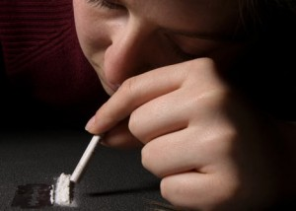
Central Nervous System Stimulants
Cocaine
Amphetamines
Methamphetamine
Caffeine
Nicotine
Dexedrine and Benzedrine
  Intoxication can create euphoria, enhanced vigor, gregariousness, hyperactivity, restlessness, interpersonal sensitivity, anxiety, tension, anger, impaired judgment, paranoia and psychosis

Slide 36
Amphetamines release dopamine, norepinephrine and serotonin
These drugs block the reuptake of these neurotransmitters.
A rush is produced similar to an orgasm like state; followed by a euphoria, alertness and increased energy and self-confidence.
Withdrawal symptoms include depression, agitation, anxiety, lethargy, insomnia, fatigue and increased appetite and hypersomnolence (excessive sleepiness)

Slide 37
Cocaine directly stimulates the brain’s reward or pleasure circuits.
It produces a sudden rise on blood pressure and accelerated heart rate. That can cause potentially dangerous and fatal results such as death.
Overdose can can produce restlessness, insomnia, headaches, convulsions, tremors, hallucinations, delusions and sudden death due to respiratory or cardiovascular collapse.
Repeated use and high dose use of cocaine can lead to depression and anxiety.

Slide 38
Amphetamines
Individuals on extended highs from amphetamines sometimes “crash” and fall into a deep sleep or depression.
A percentage of these individuals commit suicide on the way down.
High does can cause restlessness, irritability, hallucinations, paranoid delusions, loss of appetite and insomnia.
It can result in brain damage and produce deficits in learning and memory.

Slide 39
Neuroadaptation
Has vasoconstrictive effects that may outlast use and increase risk for CVA and MI
Can see psychosis associated with intoxication that resolves
Neuroadaptation: cocaine mainly prevents reuptake of Dopamine
Can develop permanent amphetamine psychosis with chronic use.

Slide 40
Hallucinogens
Hallucinogens are drugs that cause people to experience profound distortions in their perception of reality.
Hallucinogens are a mixed group of substances including LSD, MDMA (ecstasy), Peyote, PCP, Marijuana and Psilocybin (magic mushroom)
PCP, also known as angel dust is manufactured as a powder to be snorted or smoked.

Slide 41
MDMA (Ecstacy)
Designer club drug
Enhanced empathy, personal insight, euphoria, increased energy
3-6 hour durationMDMA (“Ecstasy”)
Impairs dopaminergic and serotonergic function in animal studies; human relevance unclear
Impairs executive function, inhibitory control, and decision making (as shown by cortex and limbic functional brain scan abnormalities)
Intoxication- illusions, sensitivity of touch, taste/ smell altered, "oneness with the world", tearfulness, euphoria, panic, paranoia, impairment judgment, hallucinations
Tolerance develops quickly and unpleasant side effects with continued use (teeth grinding) so dependence less likely

Slide 42
PCP
Intoxication:
Severe dissociative reactions – paranoid delusions, hallucinations, can become very agitated/ violent with decreased awareness of pain, person feels detached from self or body
Similar to an anesthetic
Cerebellar symptoms – ataxia (impaired balance) dysarthria (slurred speech) nystagmus (vertical and horizontal)
With severe overdose: mute, catatonic, muscle rigidity, hyperthermia, seizures, coma and death

Slide 43
Cannabis
Most commonly used drug in America
Drugs produced from varieties of the hemp plant are, as a group, called cannabis. They include:
The major active ingredient in cannabis is tetrahydrocannabinol (THC)
The greater the THC content, the more powerful the drug

Slide 44
Effects of cannabis appear 5-10 minutes after it is smoked.
We see changes in perception, cognition and mood.
Cognitive effects include impaired short term memory, impaired attention and concentration, inability to track thoughts, rapid flow of ideas, poor judgment.
Perceptual alterations include heightened sensitivity to all sensory modalities, colors and sounds seem brighter and richer, distortion of time, body image, depersonalization, illusions, hallucinations and sysnesthesias.
One feels euphoric, calm, relaxed, mellow, apathetic and drowsy.

Slide 45
ADVERSE EFFECTS OF HEAVY MARIJUANA USE
Respiratory Problems Such as Cough, Bronchitis, Asthma
Single large doses can trigger heart attacks in susceptible individuals.
There is no evidence that marijuana causes permanent brain damage.
There is a possible correlation between marijuana use and schizophrenia, but no causal link has been shown.

Slide 46
MEDICINAL USES OF MARIJUANA
Treats Nausea
Blocks Seizures
Dilates Bronchioles of Asthmatics
Decreases Severity of Glaucoma
Reduces Some Forms of Pain

Slide 47
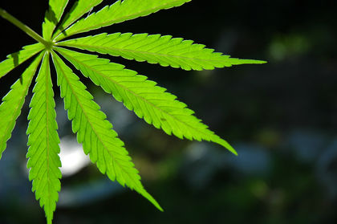
Cannabis
Most commonly used drug in America
THC levels reach peak 10-30 minutes
Intoxication-
Colors/ sounds/ tastes are clearer
Increased confidence and euphoria
Increased libido
Transient depression, anxiety, paranoia
Slowed reaction time/ motor speed
Impaired cognition
Psychosis

Slide 48
Cannabis
Increased blood pressure
Increased heart rate
Decreased respiration
Relaxation
Mild euphoria
Appetite and thirst increase
Withdrawal - insomnia, irritability, anxiety, poor appetite, depression, physical discomfort

Slide 49
Treatment Options
Hospitalization:
-Due to drug OD, risk of severe withdrawal, medical comorbidities, requires restricted access to drugs, psychiatric illness with suicidal ideation
Residential treatment:
-No intensive medical/psychiatric monitoring needs
-Require a restricted environment
-Partial hospitalization
Outpatient Program:
No risk of med/psych morbidity and highly motivated patient

Slide 50
Treatment: Stabilization Means Detoxification and Treatment
Management of acute withdrawal
Craving Stabilization
Cessation of drug use
Continuing treatment at the appropriate level of care

